Slide 1
Systematic Reviews
Dirk Riehle, Univ. Erlangen
NYT C02
Licensed under CC BY 4.0 International

Slide 2
Agenda
Systematic reviews
Research design
Study search
Study filter
Data analysis
Quality assurance

Slide 3
1. Systematic Reviews

Slide 4
Literature Review
A literature review is a
Review of existing literature for purposes of theory building
In a literature review
Relevant literature is sought out,
Analysed towards a research question, and
Synthesized towards an answer, the new or revised theory
A literature review should follow a systematic literature review methodology

Slide 5
Types of Literature Reviews
Types of literature reviews
Traditional or narrative literature reviews
Systematic literature reviews
Meta-syntheses
Related, but not a type of literature review as defined here
Meta-analyses
Not a (scientific) type of literature review
Related work (review)

Slide 6
Related Work Review
A related work review is a research practice which
Compares and contrasts existing research with current or planned research
A related work review is most commonly performed
In a research paper to bring out what is novel about the presented work
In a final thesis to clarify the thesis work’ relationship to existing work
In other words, it is a justification for what’s to be presented

Slide 7
Traditional or Narrative Literature Reviews
Traditional (or narrative) literature reviews
Choose research question to answer using traditional literature review
Perform comprehensive (researcher-expertise-driven) search for literature
Evaluate relevance (strengths and weaknesses) of found literature
Summarize findings with respect to research question
Traditional literature reviews
Lack rigor (but rely on the researcher’s expertise)
Are best viewed as well-reasoned opinions [DR]

Slide 8
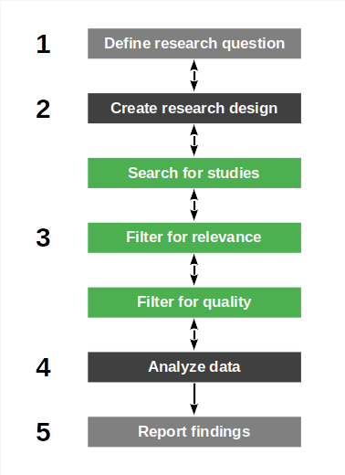
Systematic Literature Reviews (SLRs)
SLRs are a systematic approach to
Finding, analyzing, and synthesizing primary studies
SLRs are a form of systematic review
Not all systematic reviews are SLRs (but most are)
Common methodology descriptions include
Kitchenham et al. (2023), Booth et al. (2016)

Slide 9
Meta-Syntheses
Meta-syntheses are structured literature reviews that
Perform theory building using a research method, for example,
Braun & Clarke (2012): Thematic analysis
Corbin & Strauss (2008): Grounded theory

Slide 10
Meta-Analyses
Meta-analyses are literature analyses that
Quantitatively aggregate findings from different studies
Derive a more comprehensive statistical conclusion to a hypothesis
Meta-analyses are not theory building, but hypothesis testing research

Slide 11
2. Research Design

Slide 12
Systematic Literature Reviews (SLRs)
The SLR process consists of
Defining the research question
Designing the systematic review
Create research design
Create research protocol
Review research protocol
Register research protocol
Performing the review
Search for studies
Filter for relevance
Filter for quality
Analyze data

Slide 13
Define Research Questions
SLRs are open to any research question
They rely on primary materials
Are a type of secondary study
SLRs are useful for
Summarizing existing evidence
Identifying gaps in current research
Building a new research framework (theory)

Slide 14
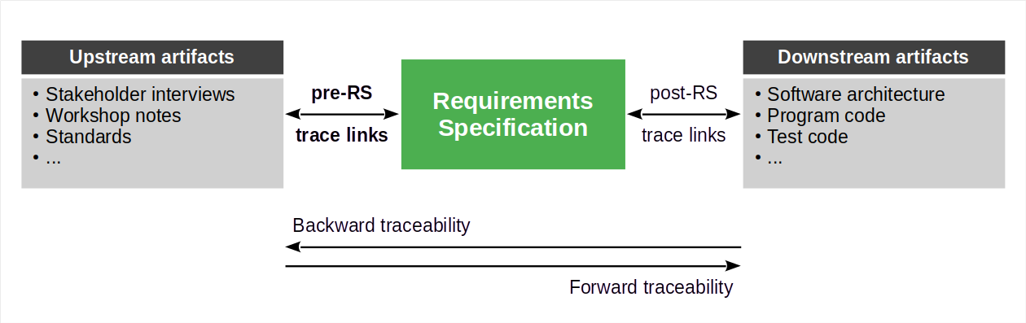
Example Research Question
Benefits of pre-Requirements-Specification traceability

Slide 15
Primary Materials / Literature
Primary materials (for an SLR) is original research
Usually as presented in publications (i.e. literature)
But also (but rarely) as the original research artifact
Be cautious to include gray literature and explain if so
Gray literature is non-peer-reviewed work
Examples are practitioner articles like blog posts

Slide 16
Create Research Design
Steps to take
Define tasks and activities
Choose research methods
Choose supporting tools
Write research protocol
For activities and methods
See the following sections

Slide 17
Tasks and Activities + Methods and Practices
Define and document tasks/activities and associated methods/practices
Study search (databases, search queries, …)
Relevance filter (inclusion/exclusion criteria, …)
Quality filter (research quality model, …)
Analysis method (e.g. thematic analysis)

Slide 18
Support Tools
Progress tracker
Lab book [1]
Literature manager
Zotero, Mendeley
ResearchGate
File system
[1] A.k.a. log book, work log

Slide 19
Create Research Protocol
Document your plan in a research protocol; this includes
Meta information
Research question
Research design
Overall process
Tasks and activities
Methods and practices
Document the what and explain the why of your choices

Slide 20
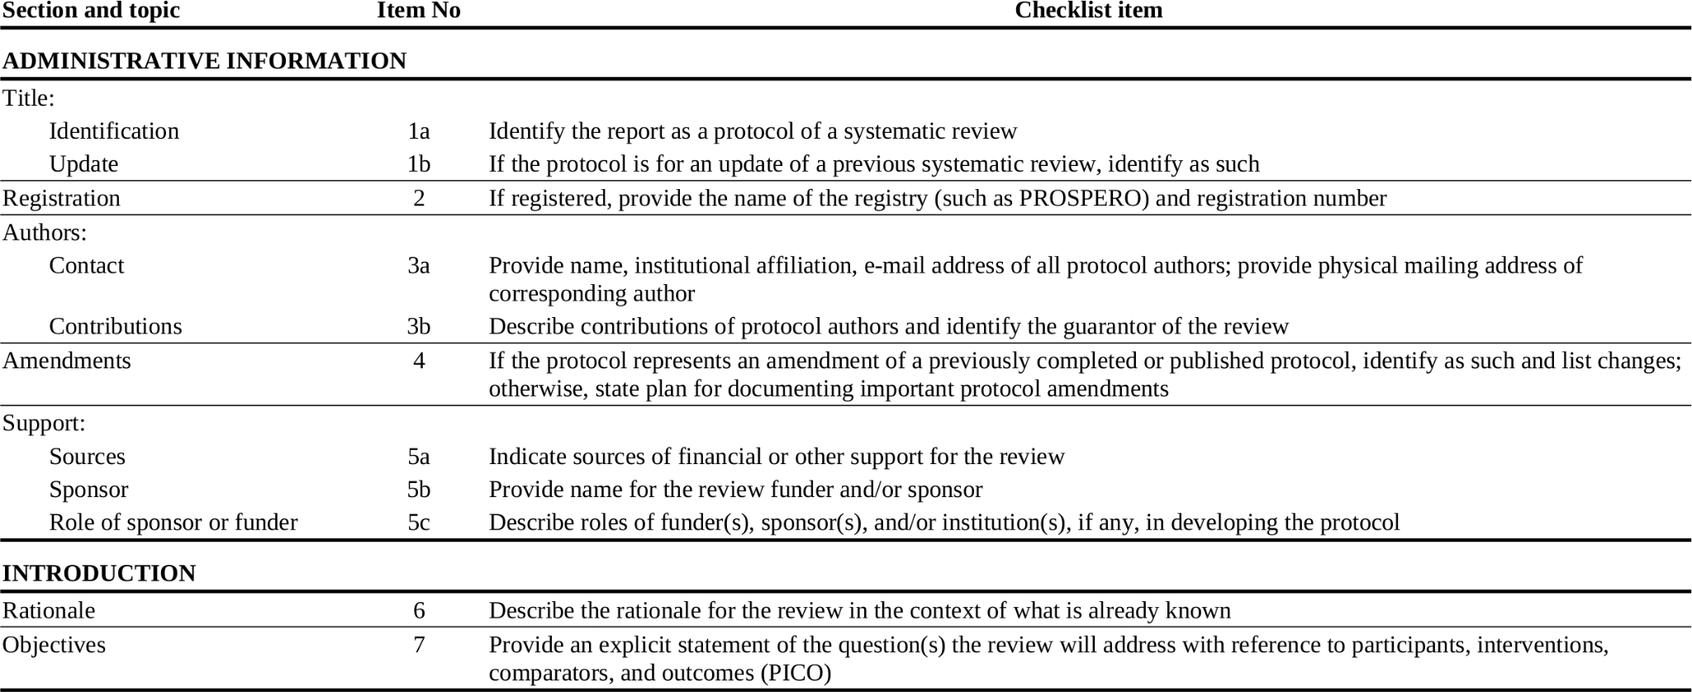
Potentially Use Protocol Following Prisma Statement [1] 1 / 2
[1] See https://prisma-statement.org/protocols/

Slide 21
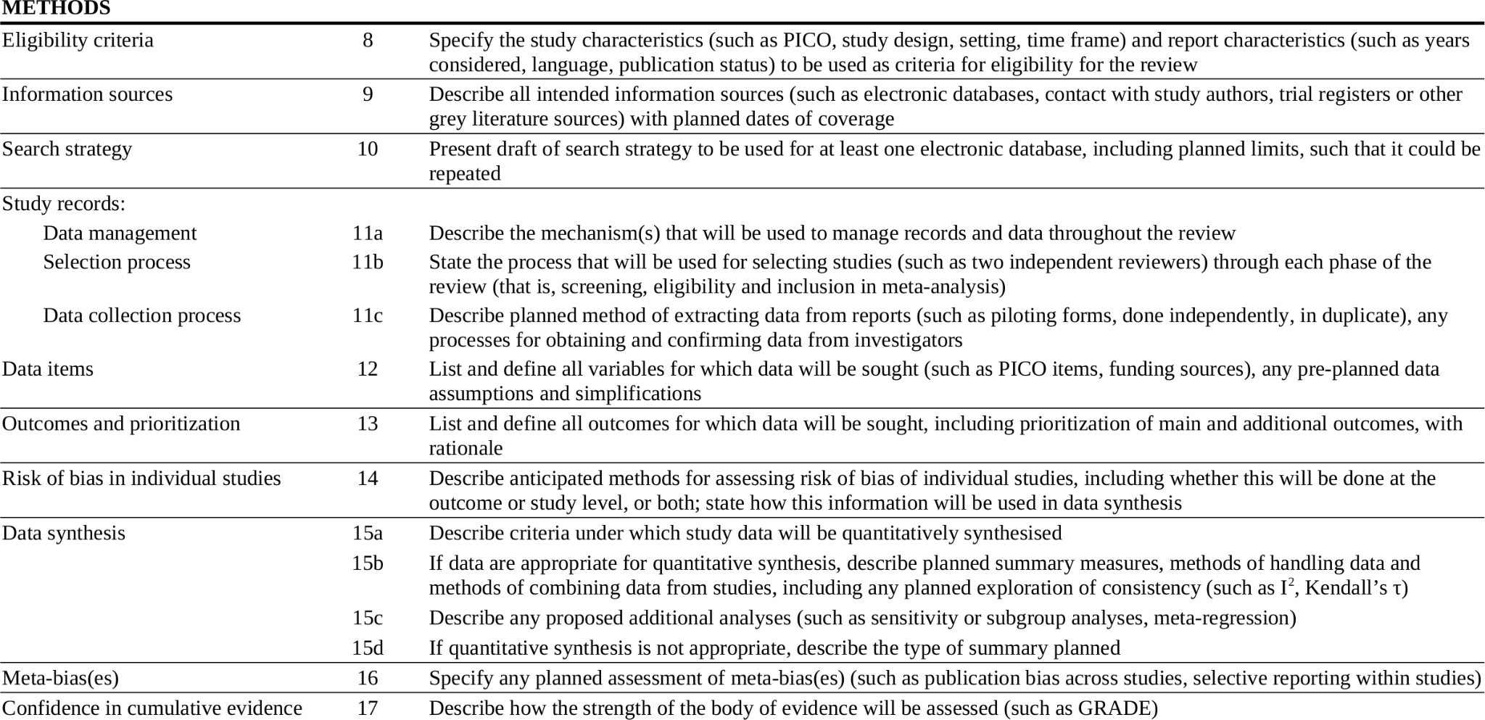
Potentially Use Protocol Following Prisma Statement 2 / 2

Slide 22
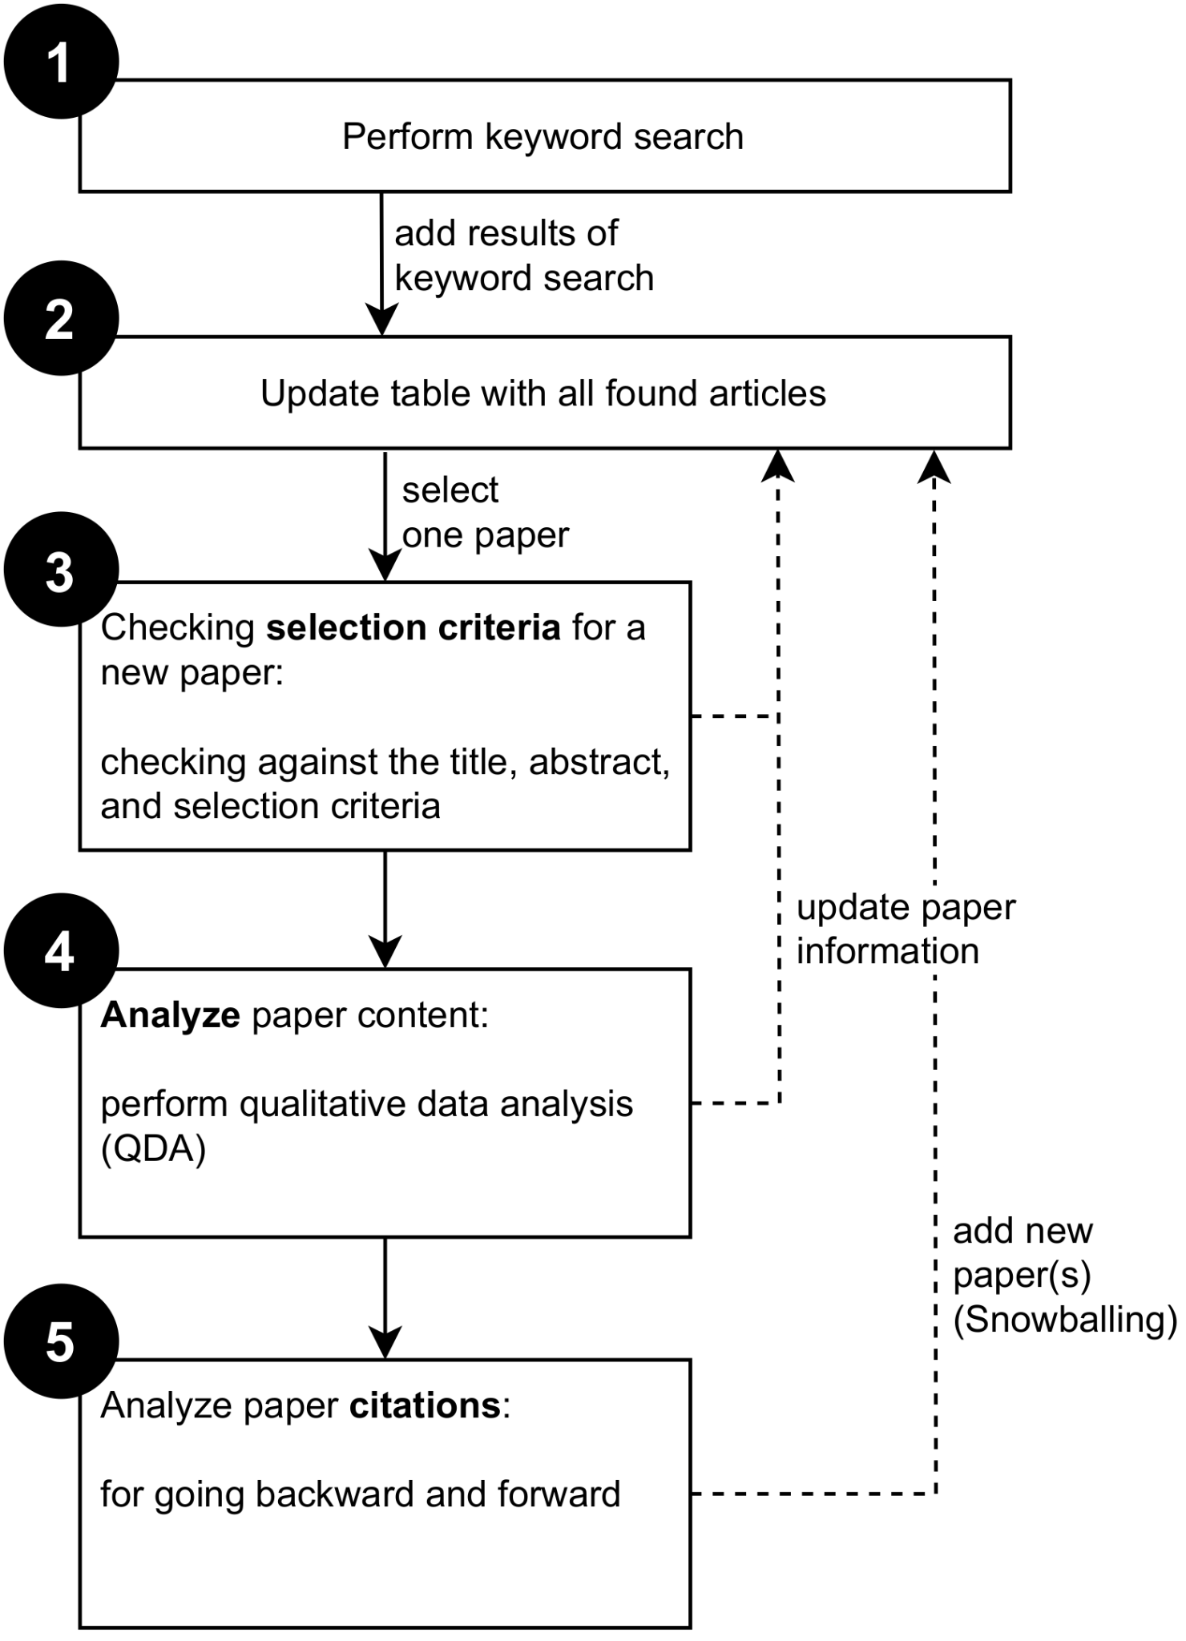
Visualization of Research Design Process
In addition to prose descriptions
Visualize the workflow
Strong in papers and theses

Slide 23
Review Research Protocol
Ask your peers or pay outside experts for feedback
Consider using Spall (1998) for peer debriefing
Iterate until satisfied

Slide 24
Register Research Protocol
Upload to arXiv (or similar registry / archive)

Slide 25
3. Study Search

Slide 26
The Search Process
Searching for studies
Define scope of search
Express scope as search query
Search and evaluate basic fit
Document the process [1]
Filtering the studies
Filter for relevance
Filter for quality
[1] See Rethlefsen et al. (2021): Reporting literature searches in systematic reviews.

Slide 27
Define Scope of Search
The search scope follows from the research question
Components of the scope definition can be
Research-question-specific terms
Meta-criteria like
Year / age of literature
Publication outlet
Type of article
Written language of article
Number of citations
Specify both inclusion and exclusion criteria!

Slide 28
Express Scope as Search Query
Codify scope as search query, usually
By conjunction of search terms
Choice of search engines, for example,
Google Scholar
ACM Digital Library
IEEE Press Digital Library
Commercial libraries e.g. Elsevier, Springer, Wiley
To learn more about commercial libraries, see
https://deal-konsortium.de/
https://sci-hub.ru/

Slide 29
Example Search Query
Benefits of pre-Requirements-Specification traceability
“pre-requirements specification traceability” OR “pre-requirements specification” OR “requirements provenance”

Slide 30
Example Keywords and Statistics
Search term | Google Scholar | IEEE DL | ACM DL | Web of Science
“pre-requirements specification traceability” | 62 | 7 | 1 | 1
“pre-requirements specification” | 133 | 20 | 6 | 1
“requirements provenance” | 42 | 1 | 2 | 11

Slide 31
Evaluate Basic Fit
Perform search using search query and search engine
For each found article, review its basic fit towards search scope
For each relevant article, perform forward and backward snowballing [1]
Backward snowballing: Review reference list of article at hand
Forward snowballing: Search for articles citing the one at hand
Snowballing may well lead you to change the search query!
[1] See Wohlin (2014): Guidelines for snowballing in systematic literature reviews.

Slide 32
Basic Fit Criteria
Basic fit criteria are formal criteria to include or exclude literature
English language?
Peer-reviewed publication?
A primary study?
The decision should be made at a glance

Slide 33
Document the Search Process
Document search queries, for example,
Date of search
Name of library
Document results of search queries, for example,
Article reference
Location (URL)
Use log book for documentation

Slide 34
4. Study Filter

Slide 35
The Filtering Process
Searching for studies
Define scope of search
Express scope as search query
Search and evaluate basic fit
Document the process [1]
Filtering the studies
Filter for relevance
Filter for quality

Slide 36
Filter for Relevance
For each retrieved article
First read title
Next read abstract
Finally read article, if necessary
Use inclusion and exclusion criteria to
Keep or drop the article at hand
If possible, use second researcher to perform same task
Ensure that disagreements are discussed and resolved

Slide 37
Inclusion and Exclusion Criteria
Use the research question to define
Inclusion criteria (keep study)
Exclusion criteria (drop study)
Ensure reliability of interpretation
Try to operationalize criteria
Have second researcher

Slide 38
Example Relevance Criteria
Is it a duplicate?
Is it written in English?
Is it the right type of study?
Does it fit the research question?

Slide 39
Filter for Quality
For each relevant article
Read the article carefully
Qualify the article
Filter the article

Slide 40
Quality Filters
Use an existing quality model [1] or create your own
Rank order by type of research, for example,
Controlled experiments over case studies
Case studies over qualitative surveys
Within each type of research, create quality levels, for example based on
Scope / breadth of evidence
Recognized biases
Define a minimum expected quality level as the filter
[1] For example, the OCEBM Levels of Evidence model, see https://www.cebm.ox.ac.uk/resources/levels-of-evidence/ocebm-levels-of-evidence

Slide 41
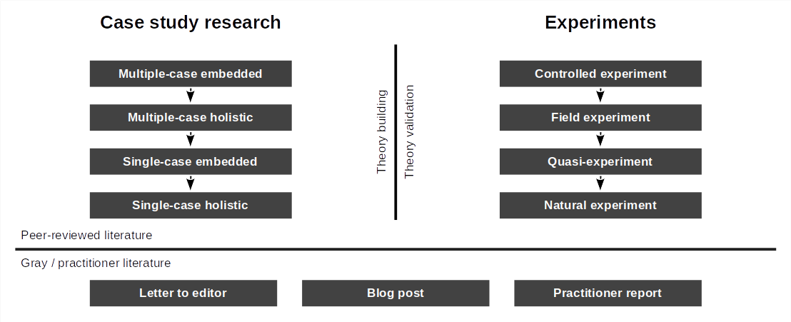
Illustration of Potential Quality Model and Its Problems

Slide 42
Dealing with Gray Literature
Gray literature can be included if
It is important for the research question
Gray literature can be excluded if
There are enough on-point primary studies
See Booth et al. (2016), p. 120, for a discussion of gray literature in SLRs

Slide 43
Document the Filtering Process
Document decisions for inclusion or exclusion
The actual decision taken
The reason for the decision (which criterion matched or was violated)
Track numbers along the search and filter funnel; at least the three stages
Is returned by query
Describes a relevant study
Passes expected quality threshold

Slide 44
4. Data Analysis

Slide 45
Data Analysis
Analyze data can be split into
Extract data
Synthesize data
There are two types of data
Descriptive metadata i.e. statistics
Content used for theory building

Slide 46
Extract Descriptive Data
Extract relevant statistical data from articles
Total number of articles
Keyword-article relationship
Trace to article (keyword, snowballing)
No citations by article (distribution)
Year of publication (distribution)
…
Focus on the article metadata, not the content

Slide 47
Interpret Descriptive Data
Interpret the data using simple means
To recognize keyword trends
To recognize publication trends
Some descriptive analysis may also be interesting
Who is publishing?

Slide 48
Qualitative Data Analysis
Perform qualitative data analysis using an appropriate method, e.g.
Corbin & Strauss (2012): Grounded theory
Brown & Clarke (2012): Thematic analysis

Slide 49
Example Coding Statistics of Pre-RS Traceability SLR
Codes | Number of codings
Requirements Traceability | 5
Pre-RS traceability general (+ subcodes) | 81
Applying pre-RS traceability (+ subcodes) | 31
Use cases and benefits | 249
Problems and challenges (+ subcodes) | 275
Consequences of poor pre-RS traceability | 5
Solutions and suggestions (+ subcodes) | 258
Trace techniques (+ subcodes) | 212
Trace tools (+ subcodes) | 48

Slide 50
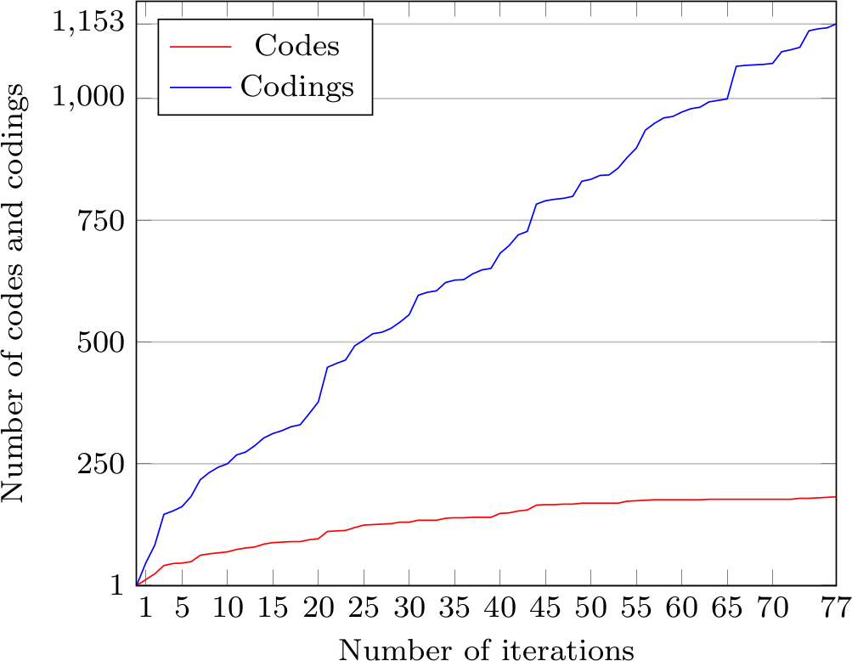
Example Saturation Criterion of Pre-RS Traceability SLR

Slide 51
5. Quality Assurance

Slide 52
Relevant Quality Criteria
Clear selection criteria
Complete and exhaustive
Clear documentation of methods
Searching and filtering
Data analysis
Clear chain of evidence to results

Slide 53
Summary
Systematic reviews
Research design
Study search
Study filter
Data analysis
Quality assurance

Slide 54
Thank you! Any questions?
dirk.riehle@fau.de – https://oss.cs.fau.de
dirk@riehle.org – https://dirkriehle.com – @dirkriehle

Slide 55
Legal Notices
License
Licensed under the CC BY 4.0 International license
Copyright
© 2012, 2023 Dirk Riehle, some rights reserved

